Slide 1
Fine-tune and deploy with PEFT on AWS
Generative AI Foundations on AWS
Anastasia Tzeveleka, Sr. ML Specialist SA at AWS
Level 300
Notes:
Hi everybody, welcome to the Generative AI Foundation on AWS series. My name is Anastasia Tzeveleka and I am a Senior Machine Learning Specialist Solutions Architect at AWS. And today you will learn how to fine-tune and deploy models using Performance Efficient Fine Tuning or in short PEFT on AWS. PEFT allows us to reduce the time and cost it takes to fine-tune models for specific tasks using our selected datasets. So let’s get started.
Abstract: In this session, you will learn how to fine tune LLMs using PEFT with SageMaker Training and how to deploy your model to a SageMaker endpoint for inference. We also present the infrastructure options when using SageMaker (NVidia GPUs vs AWS custom silicon) for PEFT fine tuning, best practices and implementation approach for each. You will also see a real time demo of the concepts discuss.

Slide 2
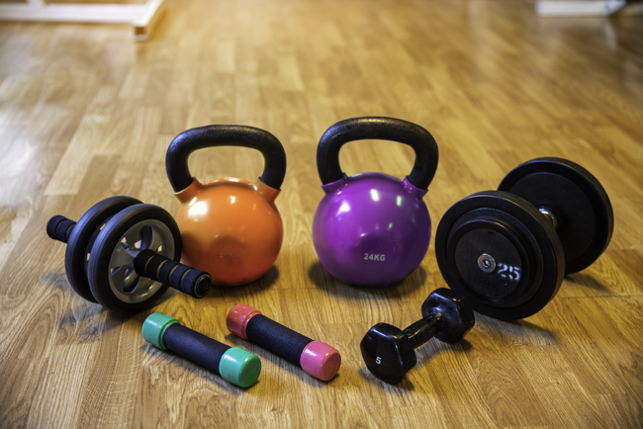
Today’s activities
Why Parameter Efficient Fine Tuning (PEFT)
Popular PEFT methods: LoRA and QLoRA
The PEFT library from Hugging Face
Fine-tune and deploy with PEFT on AWS
Hands-on walk through: Fine-tune and deploy with PEFT and Amazon SageMaker
Reminder – everything we discuss today is possible on AWS and SageMaker!
Notes:
So this session is about Parameter Efficient Fine Tuning or PEFT, why we need to know about it, how it works and some of the PEFT methods that are available. In particular we will take a look at Low Rank adaptation LoRA and QLoRA, these are two very popular methods, and understand how they work.
We will learn about the PEFT library from Hugging Face and how you can use it to easily fine-tune and deploy your models. And will will understand how
learn about the PEFT library from Hugging Face and how you can use it to fine-tune and deploy your models with PEFT. And we will see how you can fine-tune and deploy your models using PEFT and managed infrastructure through Ama
And we will close with a hands-on walkthought of how you can do all of that on Amazon SageMaker.

Slide 3


Many ways to customize a foundation model
Pretraining
Fine-tuning *
Accuracy
Prompt engineering
Retrieval augmented generation
Complexity and cost
Notes:
Quicker Development
The pre-trained model weights already encode a lot of information. As a result, it takes much less time to train our fine-tuned model - it is as if we have already trained the bottom layers of our network extensively and only need to gently tune them for a specific task.
Less Data
In addition and perhaps just as important, because of the pre-trained weights this method allows us to fine-tune our task on a much smaller dataset than would be required in a model that is built from scratch. A major drawback of NLP models built from scratch is that we often need a prohibitively large dataset in order to train our network to reasonable accuracy, meaning a lot of time and energy had to be put into dataset creation. By fine-tuning a model, we are now able to get away with training a model to good performance on a much smaller amount of training data.
Better Results
Finally, this simple fine-tuning procedure (usually adding one fully-connected layer on top of model and training for a few epochs) was shown to achieve state of the art results with minimal task-specific adjustments for a wide variety of tasks: classification, language inference, semantic similarity, question answering, etc.

Slide 4
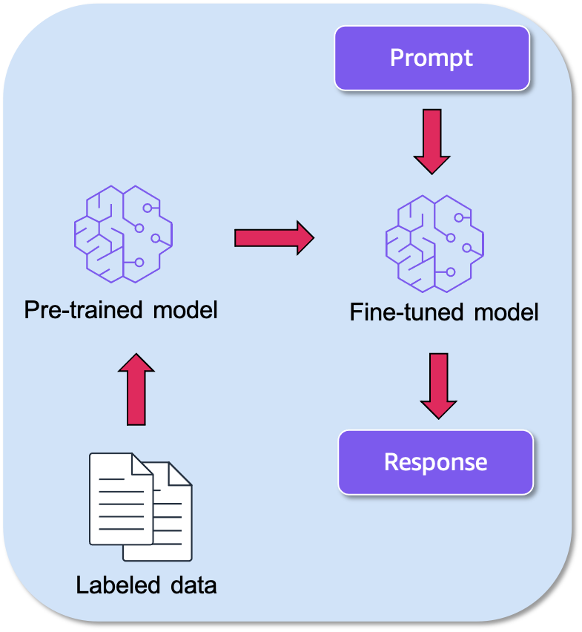
Quick recap of fine-tuning
With fine-tuning you improve model performance on downstream tasks.
You retain the model architecture and train all model parameters using a smaller dataset. As a result, you need less memory and compute than in full pre-training.
It may lead to catastrophic forgetting where the model forgets knowledge learned during pre-training.
Notes:
You need ~2GB to store 1B parameters at 16-bit (fp16, bfloat16)
For a 176B model, this translates to 5 GPUs with 80GB RAM . In addition we need to Plus memory for optimizer state, activations and gradients.
Quicker Development
The pre-trained model weights already encode a lot of information. As a result, it takes much less time to train our fine-tuned model - it is as if we have already trained the bottom layers of our network extensively and only need to gently tune them for a specific task.
Less Data
In addition and perhaps just as important, because of the pre-trained weights this method allows us to fine-tune our task on a much smaller dataset than would be required in a model that is built from scratch. A major drawback of NLP models built from scratch is that we often need a prohibitively large dataset in order to train our network to reasonable accuracy, meaning a lot of time and energy had to be put into dataset creation. By fine-tuning a model, we are now able to get away with training a model to good performance on a much smaller amount of training data.
Better Results
Finally, this simple fine-tuning procedure (usually adding one fully-connected layer on top of model and training for a few epochs) was shown to achieve state of the art results with minimal task-specific adjustments for a wide variety of tasks: classification, language inference, semantic similarity, question answering, etc.

Slide 5
What is Parameter Efficient Fine Tuning (PEFT)?
You freeze most of the original model parameters and replace or extend model layers by training a small number of parameters for downstream tasks (question answering, classification etc.)
Foundation Model
(Billions of parameters)
Task 1 specific parameters
Task 1
Foundation Model
(Billions of parameters)
Task 2 specific parameters
Task 2
Foundation Model
(Billions of parameters)
Task N specific parameters
Task N
Notes:
tate-of-the-art models are massively over-parameterized
Parameter-Efficient Fine-Tuning (PEFT) methods enable efficient adaptation of pre-trained language models (PLMs) to various downstream applications without fine-tuning all the model's parameters. Fine-tuning large-scale PLMs is often prohibitively costly.

Slide 6

Why use PEFT?
With PEFT you can approximate fine-tuning performance on downstream tasks with less compute and at lower cost.
You can train faster and with smaller datasets.
Checkpoints are typically very small (typically MBs).
During inference you combine the pre-trained model and the trained parameters. By keeping the pre-trained model weights you overcome the risk of catastrophic forgetting.
You can fine-tune your model for different tasks and hot swap the trained weights during inference.
Notes:
This also helps to motivate why we care about these techniques - they can help you save a lot of money and time in training. They also let you work with smaller datsets. It would be helpful to summarize these in 1 slide, the benefits of these methods, so it's clear.
80GB GPU
1 GB of GPU RAM you can fine about 1B parameter model if you quantize to 8-bit
2GB of GPU RAM is around 1B parameters fp16, bfloat16

Slide 7

There are many kinds of PEFT
Prompt tuning, Prefix-Tuning, P-tuning, LoRA, QLoRA, Adapters, IA3, and many more…
Considerations when selecting a PEFT method
Does it work for the model’s modality?
What is the size of the foundation model?
How many trainable parameters does it typically need?
What are the memory and storage requirements?
Is there inference overhead?
How much does a small decrease in accuracy matter for my use case?
Notes:
You can combine PEFT techniques

Slide 8
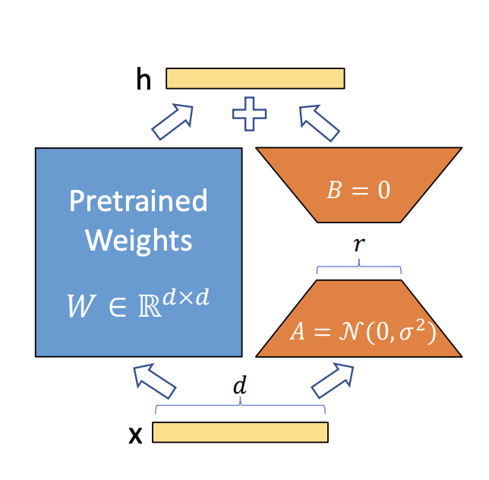
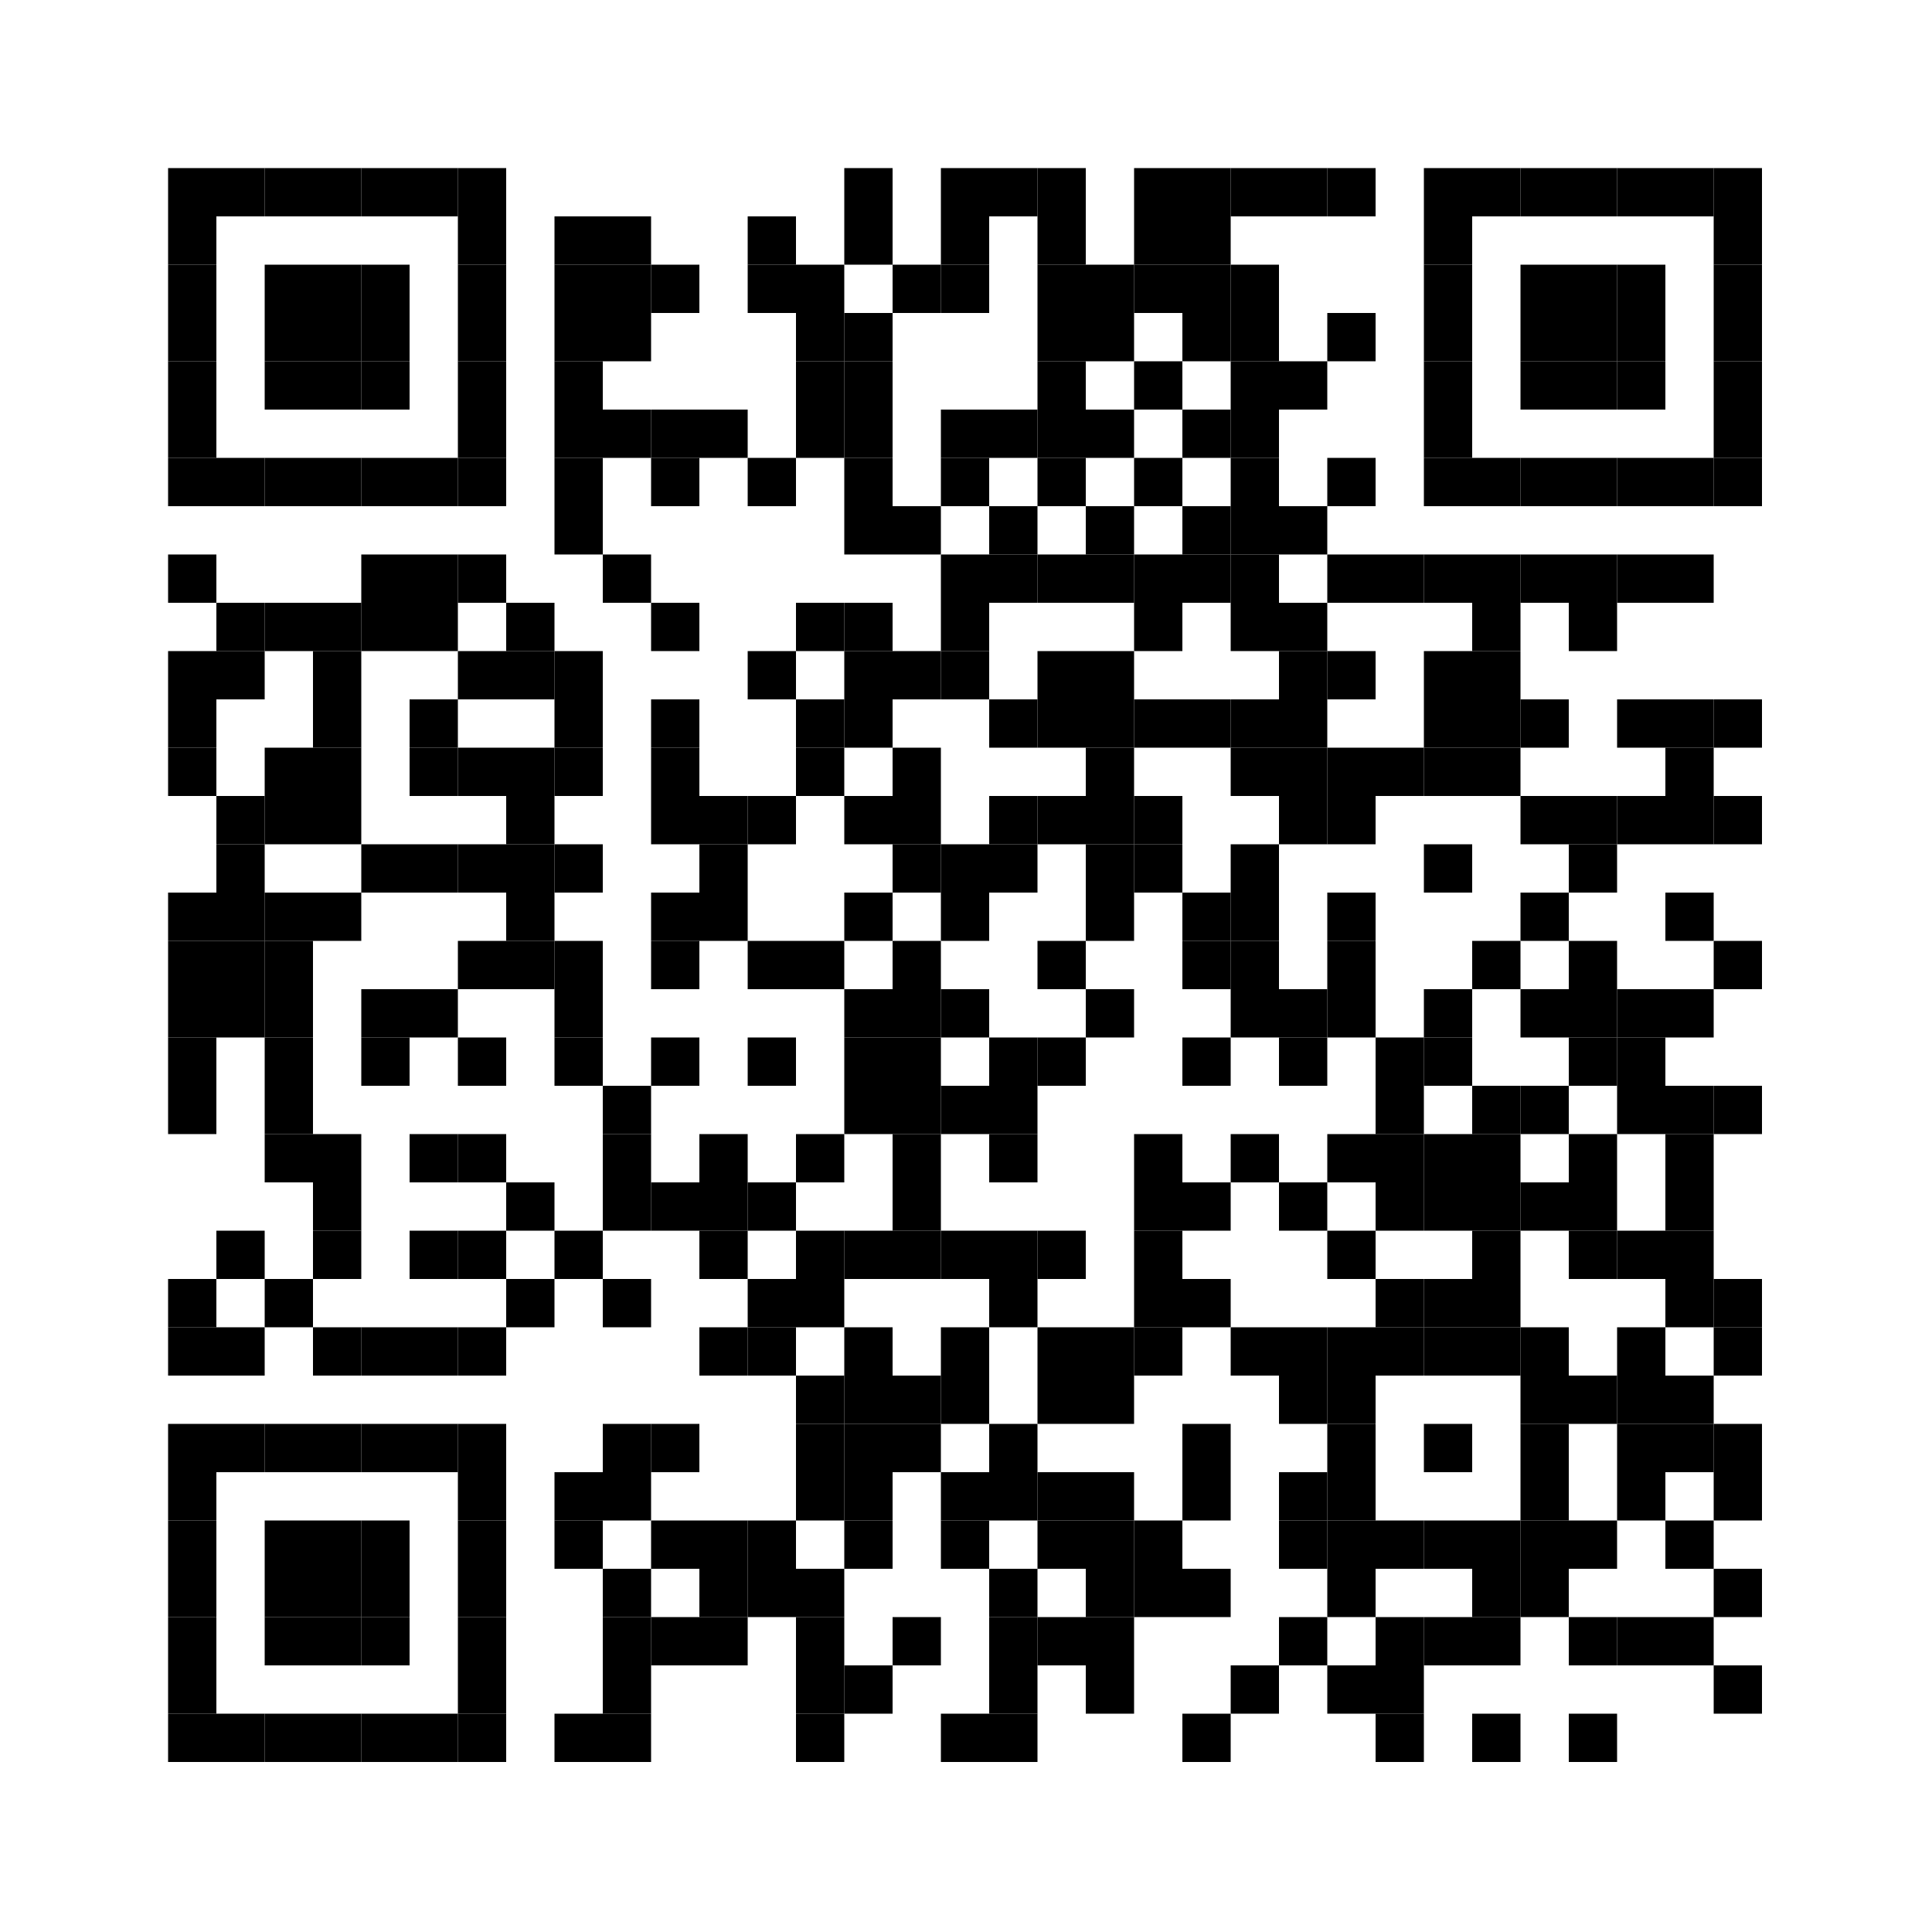
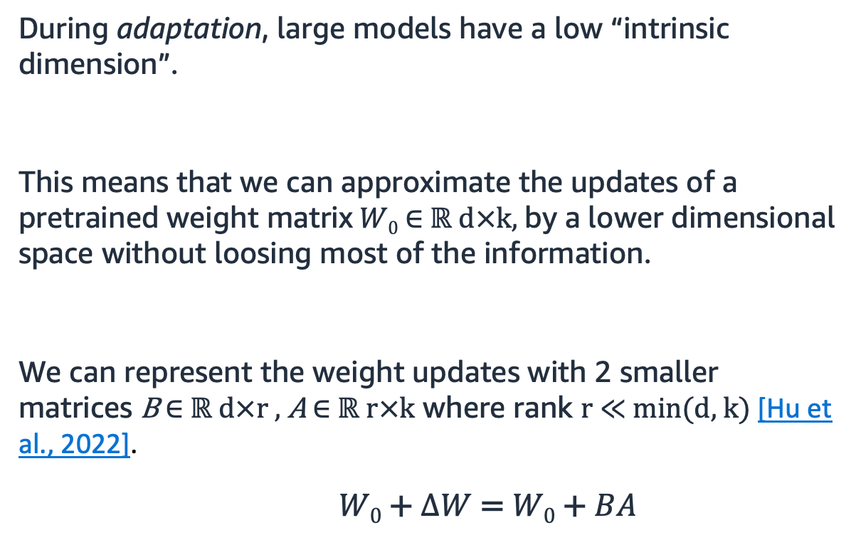
How Low Rank Adaptation (LoRA) works
During adaptation, large models have a low “intrinsic dimension”.
This means that we can approximate the updates of a pretrained weight matrix $W0$ ∈ $ℝ d×k$, by a lower dimensional space without loosing most of the information.
We can represent the weight updates with 2 smaller matrices B ∈ $ℝ d×r$ , A ∈ $ℝ r×k$ where rank r $≪$min(d, k) [Hu et al., 2022].
$W0$ + $∆W$= $W0$ + $BA$
Source: Hu et al. 2021
https://arxiv.org/abs/2106.09685
Frozen
Notes:
Instead of training all of the weights e.g. all the 175B weights, you make a low rank representation of the gigantic matrix to 2 smaller matrices the rank of which is very small, often it equals 4. If we can represent these weights with the low rank representation and just train h those, the results are very big. This means I can freeze the weights, I don’t have to do updates, I don’t have to store any of the overhead that’s needed in terms of back propagation. It can be trained on a single GPU and requires much less RAM.
Rank appears to be task-dependent, the relationship between rank and
https://www.youtube.com/watch?v=KoOlcX3XLd4
To make fine-tuning more efficient, LoRA’s approach is to represent the weight updates with two smaller matrices (called update matrices) through low-rank decomposition. These new matrices can be trained to adapt to the new data while keeping the overall number of changes low. The original weight matrix remains frozen and doesn’t receive any further adjustments. To produce the final results, both the original and the adapted weights are combined.
LoRA is orthogonal to many other parameter-efficient methods and can be combined with many of them.

Slide 9
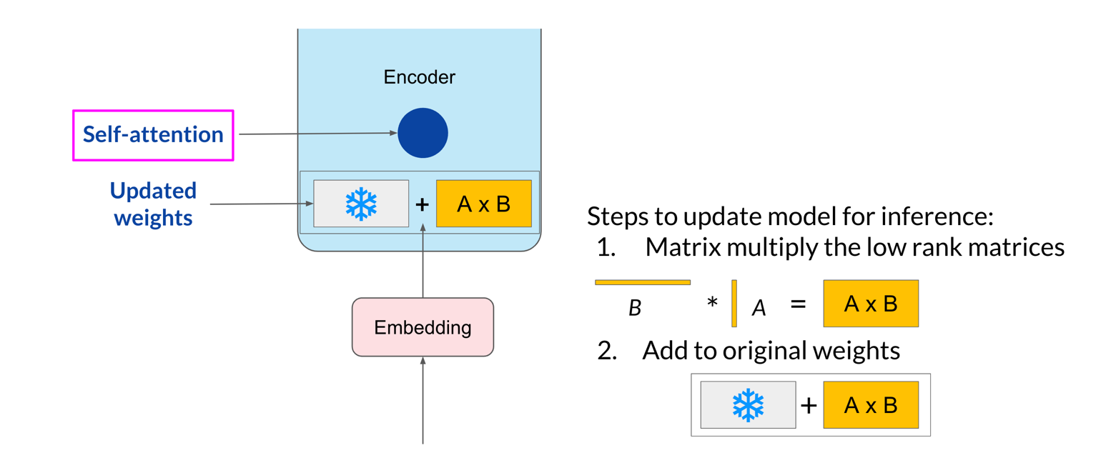
Using LoRA during inference

Slide 10
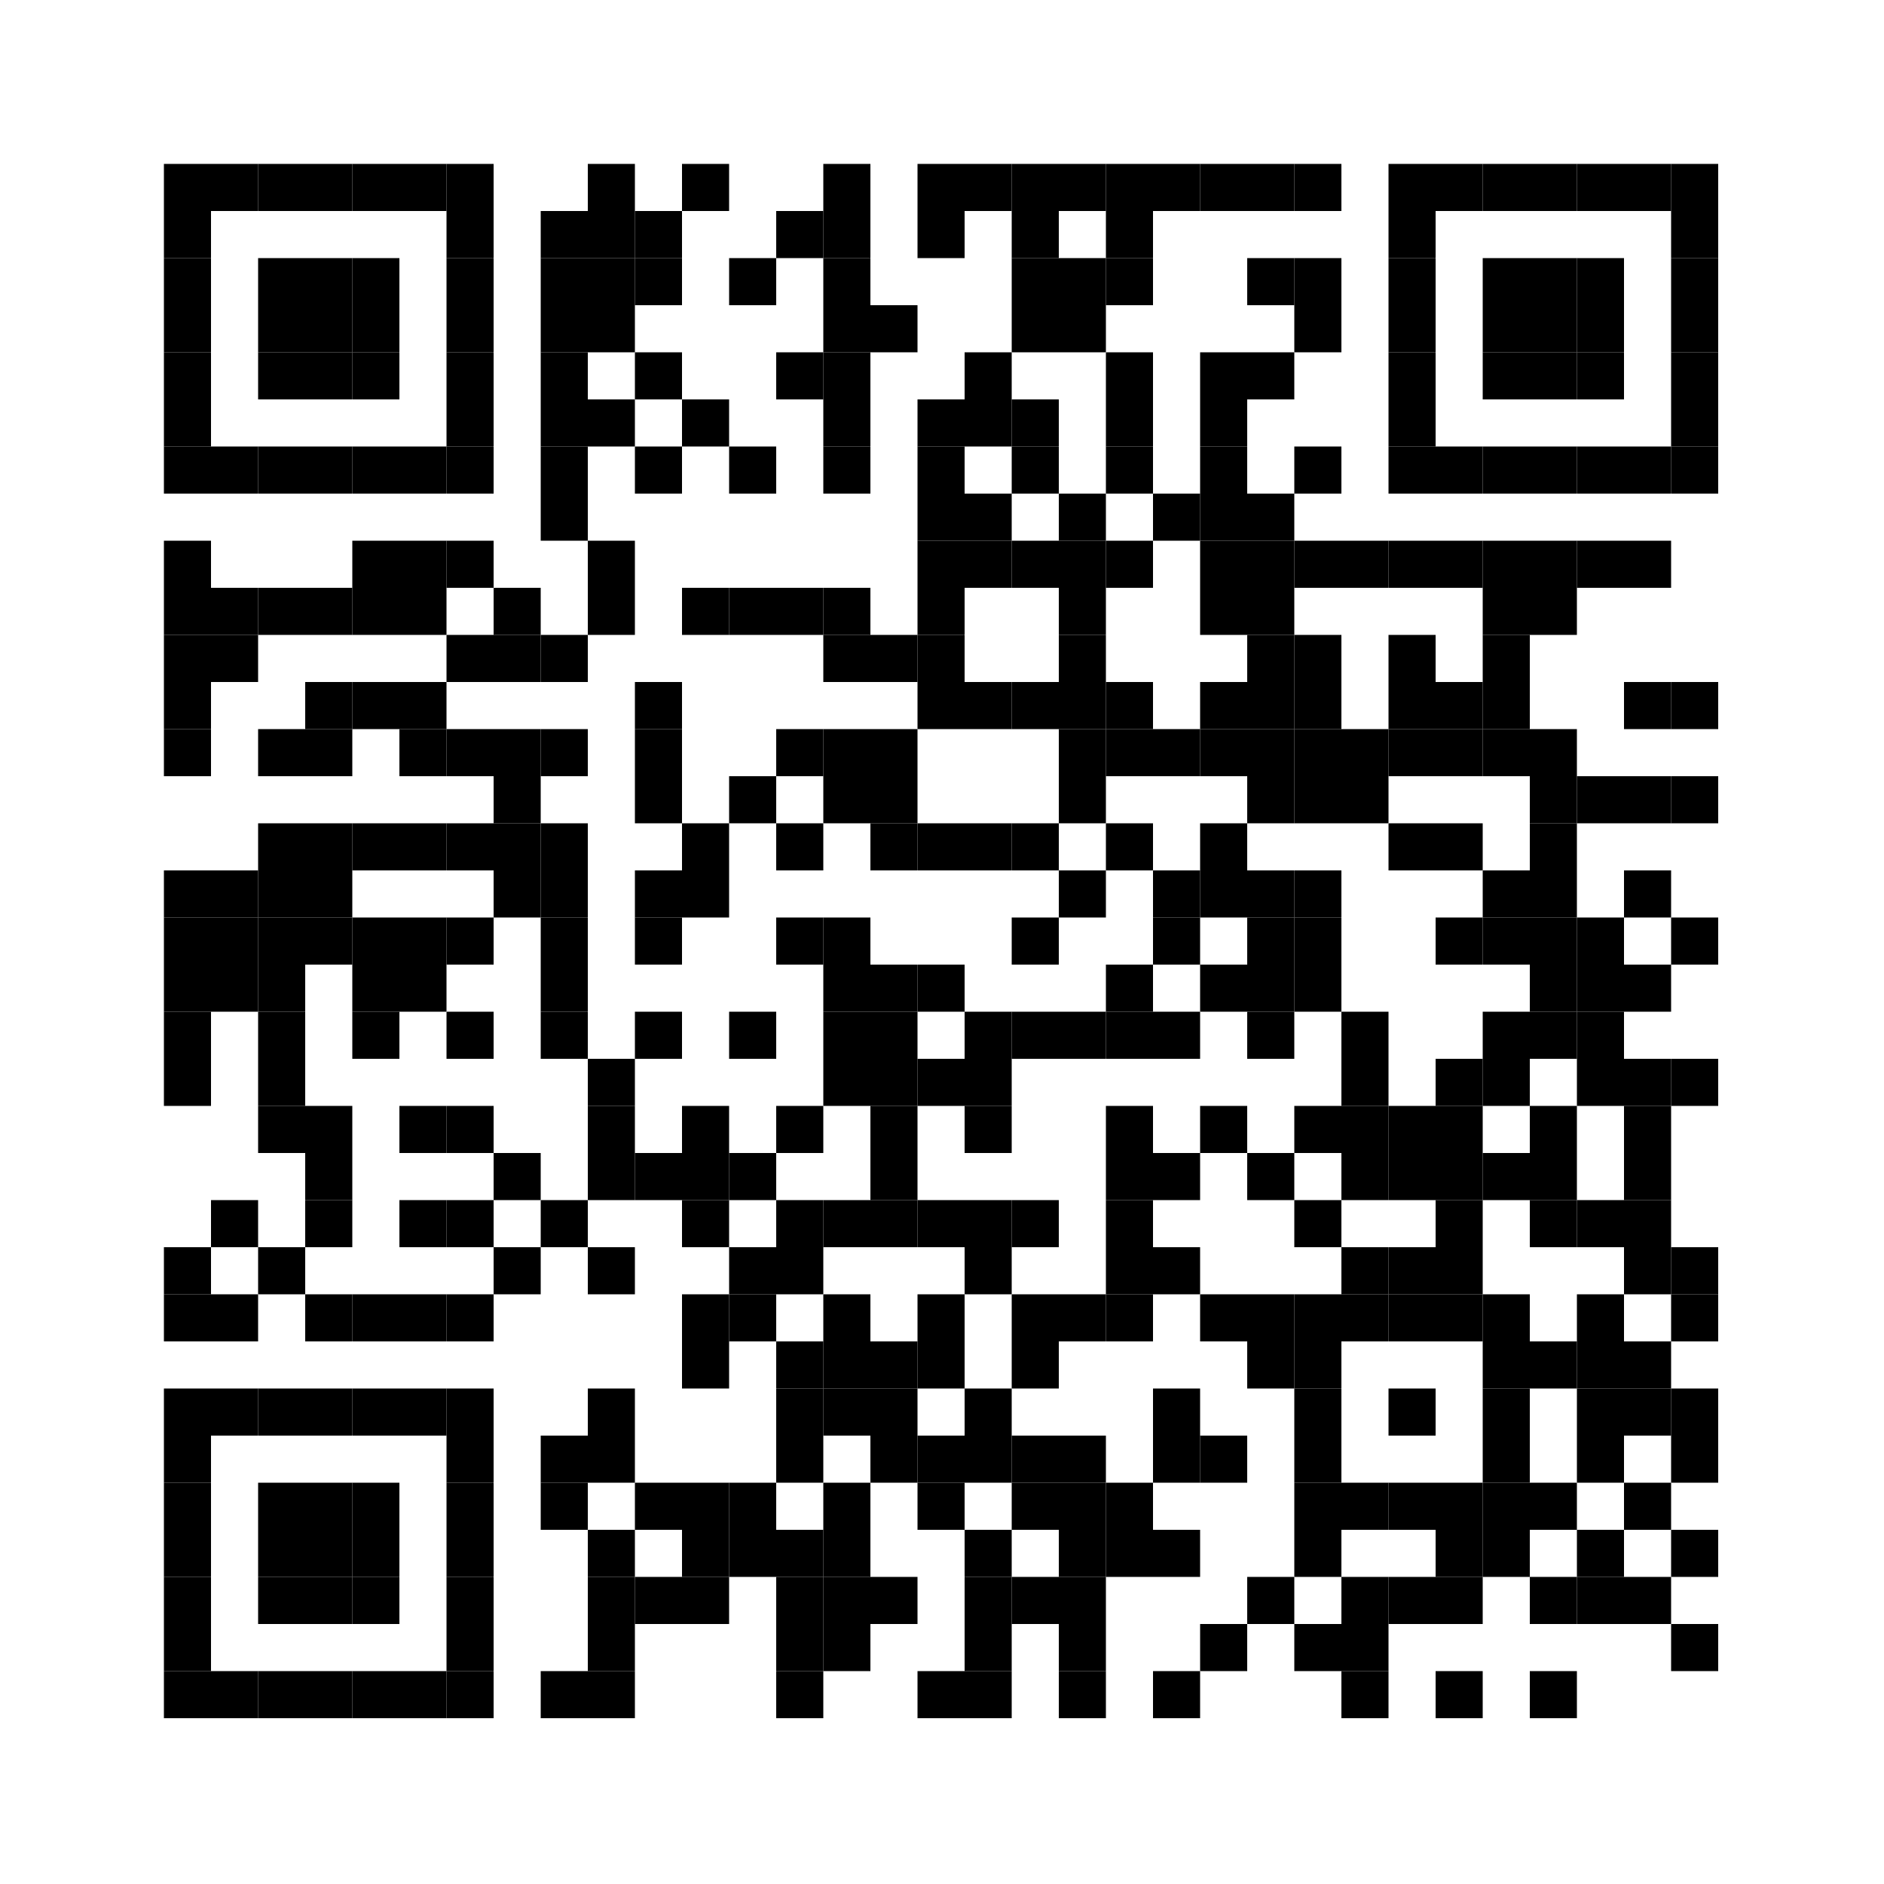
Quantized Low-Rank Adapters (QLoRA)
With QLoRA you can reduce the required memory further and still approximate the full-precision model fine-tuning.
You quantize the pre-trained model to 4 bits using NormalFloat (NF4) quantization and Double Quantization techniques.
You freeze the model parameters and add a small number of trainable parameters as Low-Rank Adapters.
During fine-tuning, QLoRA fine tunes the LoRA Adapters (16-bit)
According to the QLoRA paper by T. Dettmers et al. you can fine-tune 65 billion parameter model on a single 48GB GPU
arxiv.org/pdf/2305.14314.pdf

Slide 11
PEFT
🤗
Hugging Face library which helps you integrate PEFT methods
with 🤗 Transformers and 🤗 Accelerate.
https://github.com/huggingface/peft
Apply SOTA PEFT methods
LoRA, Prompt Tuning, P Tuning, AdaLoRA, IA3 and more
Use with a range of models
GPT-3, GPT-J, OPT, BLOOM, LLaMA, Stable Diffusion and more
Apply PEFT for image and text related downstream tasks
Combine PEFT techniques with int8 quantization

Slide 12





Steps to fine-tune a model with PEFT
🤗
1
Load pre-trained model and model tokenizer
2
Load the fine-tuning
dataset
3
Tokenize the dataset
6
Deploy and evaluate
5
Fine-tune your model
4
Configure the model for
a specific PEFT method

Slide 13
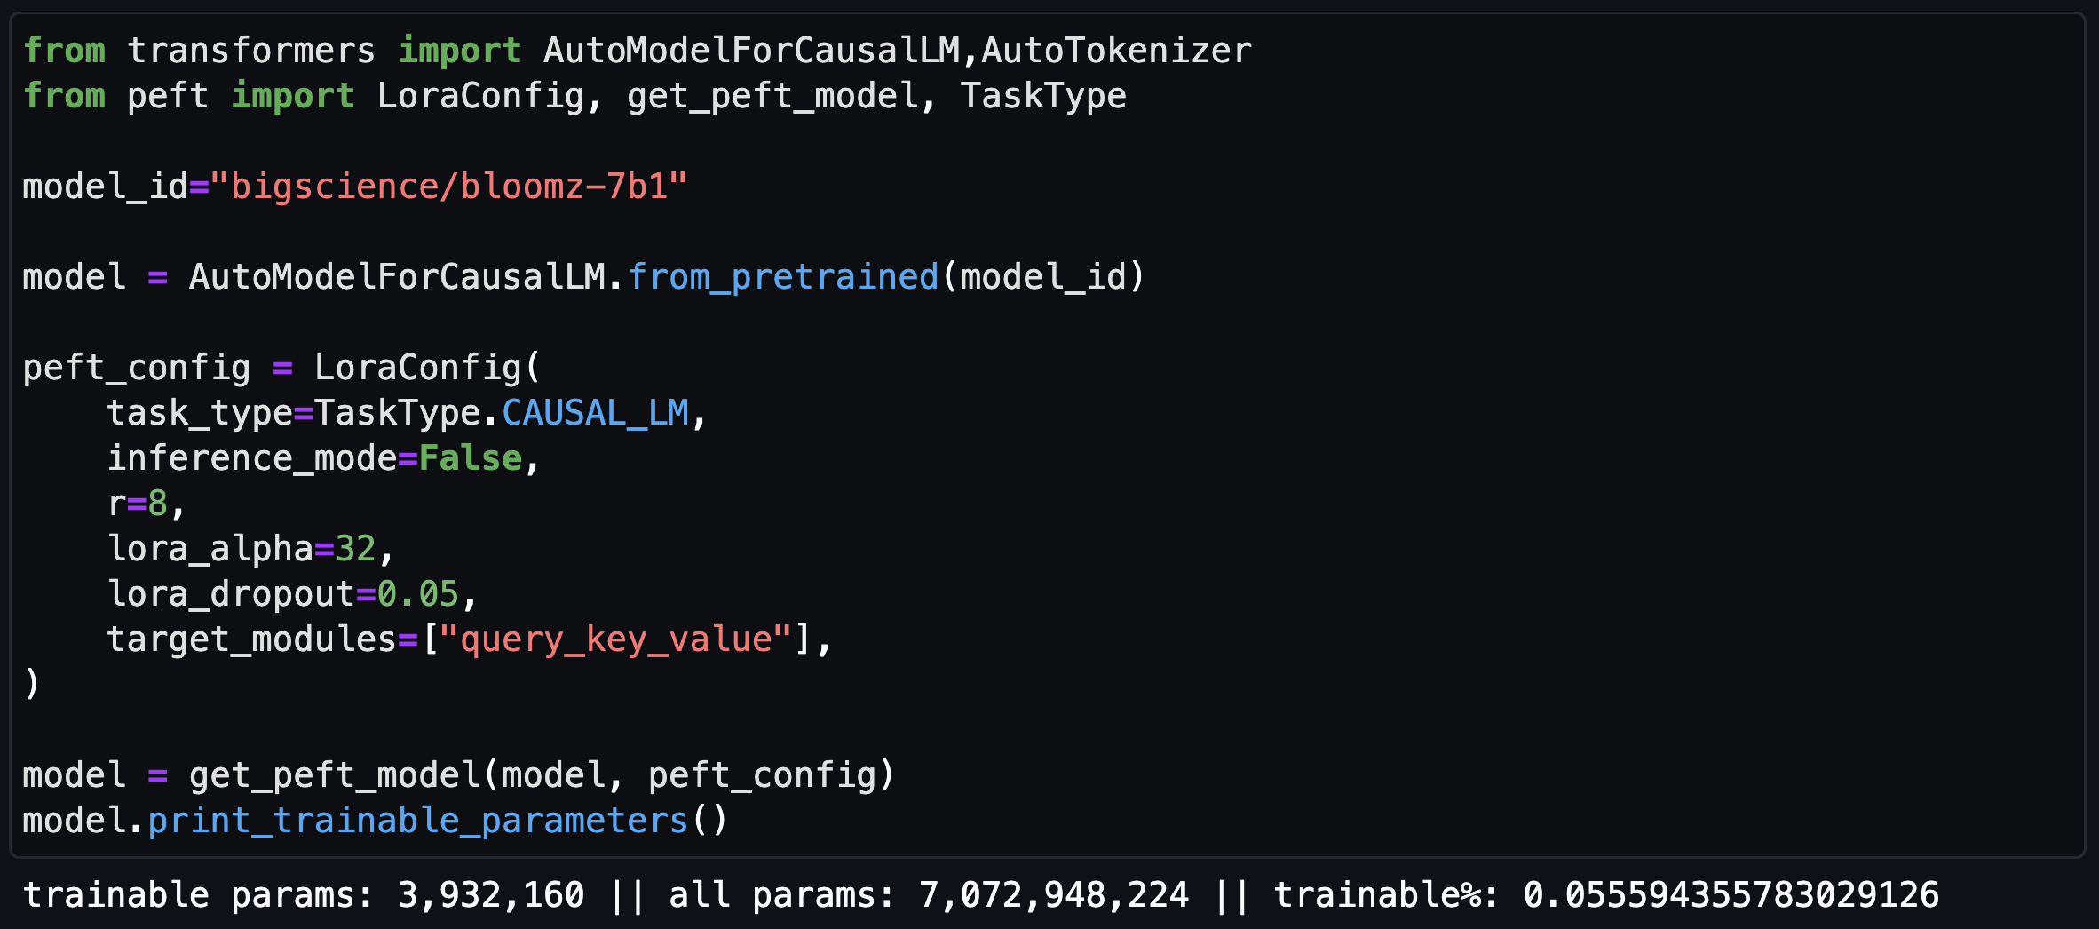
Using PEFT for LoRA fine-tuning
🤗
rank of the update matrices

Slide 14
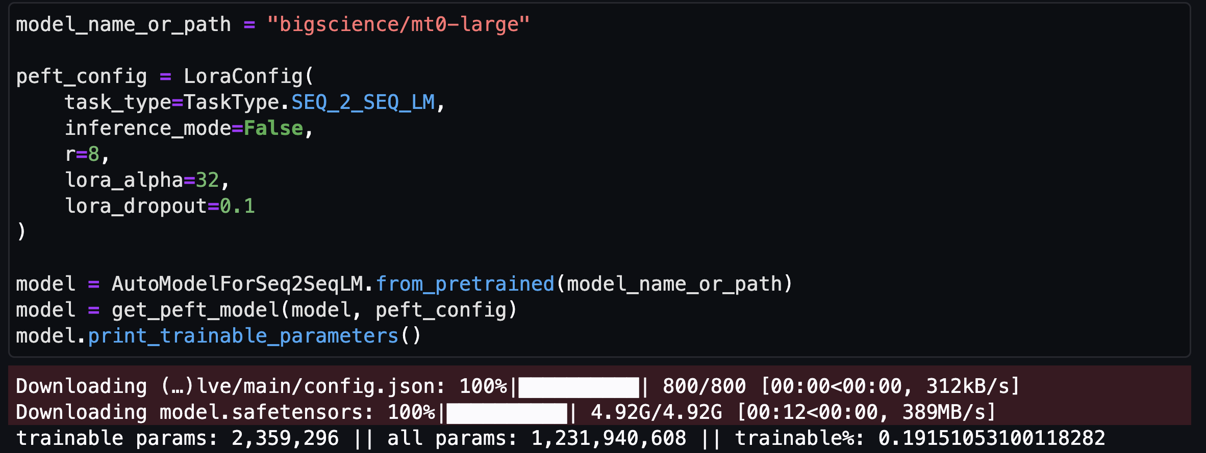
Using PEFT for LoRA fine-tuning
🤗
rank of the update matrices

Slide 15
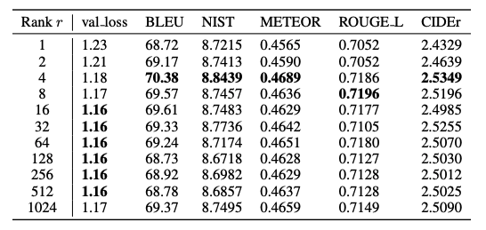
How do I choose the rank?
Test for your task and dataset
Higher values are not necessarily more effective
Validation loss and test set metrics on E2E NLG Challenge achieved by LoRA
with different rank r using GPT-2 Medium
Source: Hu et al. 2021
https://arxiv.org/abs/2106.09685

Slide 16
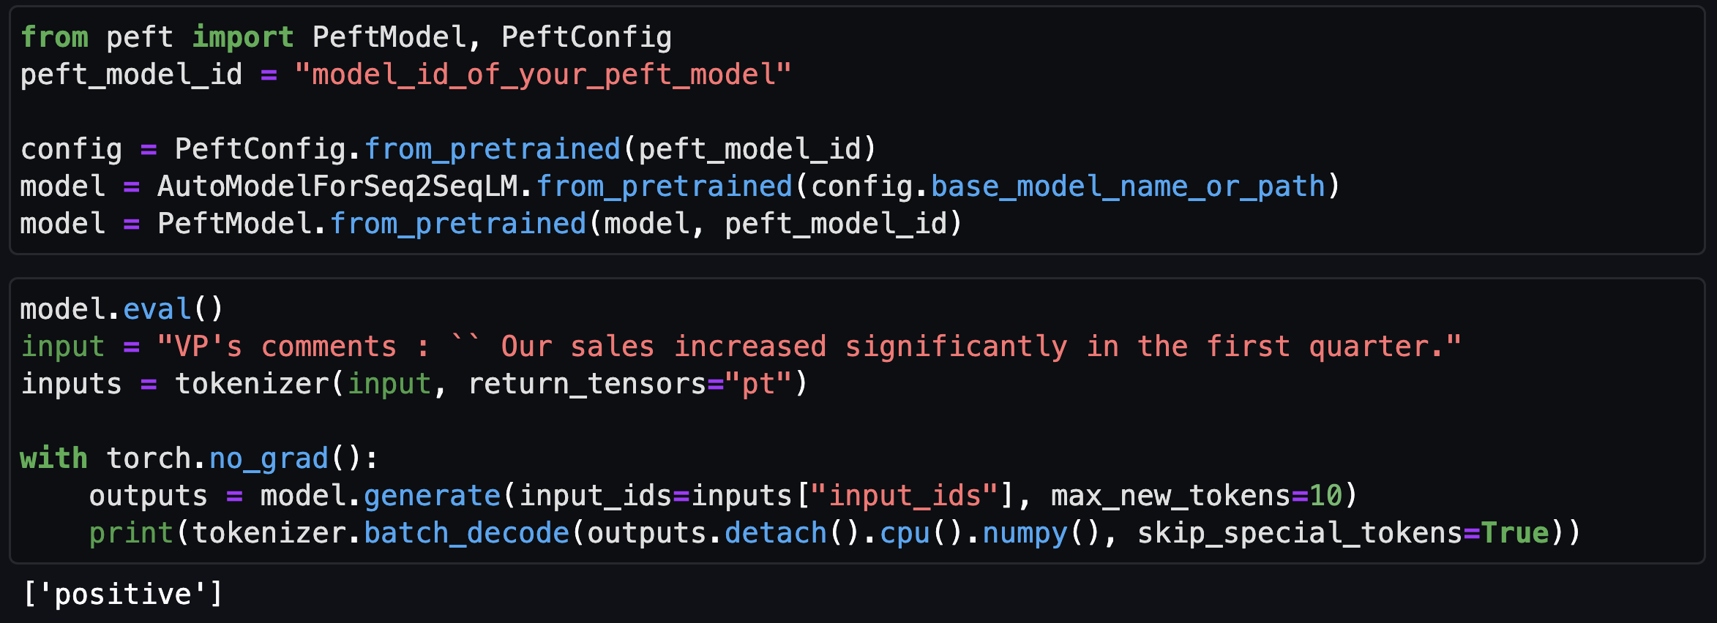
Evaluate your PEFT model
🤗
the PEFT model
the foundation model
Notes:
model (PreTrainedModel) — The model to be adapted. The model should be initialized with the from_pretrained method from the 🤗 Transformers library. model_id (str or os.PathLike) — The name of the PEFT configuration to use. Can be either: A string, the model id of a PEFT configuration hosted inside a model repo on the Hugging Face Hub.
A path to a directory containing a PEFT configuration file saved using the save_pretrained method (./my_peft_config_directory/).
adapter_name (str, optional, defaults to "default") — The name of the adapter to be loaded. This is useful for loading multiple adapters. is_trainable (bool, optional, defaults to False) — Whether the adapter should be trainable or not. If False, the adapter will be frozen and use for inference
https://huggingface.co/docs/peft/package_reference/peft_model

Slide 17





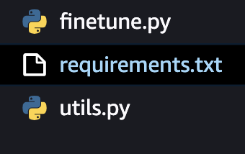
What you need to fine-tune a model with PEFT on Amazon SageMaker
🤗
Fine-tuning dataset
Model
Training container image
Managed instances
Pro tip
Point to the latest AWS Deep Learning Container to easily execute your training script.
Add a requirements txt file in the same directory as your fine-tuning script and include peft as a library.
SageMaker will run pip install and install it when the training starts
Fine tuning code
Notes:
Considerations:
What happens if my model is in the hugging face format but not in the hugging face hub?
What happens if I want to use my own container?

Slide 18



Example: fine-tune BloomZ–7B using LoRA and SageMaker
Download and visualize the dataset
Fine-tuning 3.9M parameters for a summarization task took us 5.7 hours when using the samsum dataset from Hugging Face and a single A100 instance ml.g5.2xlarge
1
Preprocess the data and store it in Amazon S3
2
Amazon S3
model artifacts
SageMaker Notebook
Start training job
3
LoRA with int8 quantization
4
Evaluate your model
🤗
BloomZ – 7B float 16

Slide 19
What you need to host a model fine-tuned with PEFT on Amazon SageMaker
🤗
Model artifacts
Training container image
Managed instances
Inference code
Pro tip
First, test your fine-tuned model locally on your notebook to make sure it is working properly.
When you are ready, point to the latest AWS Deep Learning Container to deploy it on Amazon SageMaker
Notes:
Considerations:
What happens if my model is in the hugging face format but not in the hugging face hub?
What happens if I want to use my own container?

Slide 20
Example: Host BloomZ–7B with PEFT on accelerators with Amazon SageMaker
1
Deploy the model
SageMaker Notebook
SageMaker Endpoint
2
Start making predictions
Pro tip
If your model requires multiple accelerators for hosting or if you want to accelerate inference with a supported model such as GPT, Bloom, Llama, and OPT use the AWS Large Model Inference container.

Slide 21
Hands-on demo

Slide 23

Scan for slides

